Slide 1
Exploring the Impact of Lifestyle and Health Factors on Diabetes Risk
A Statistical Analysis Using BRFSS Data
Presented by
Team 5
Alekhya Tentu
Rohit Eerabattini
Kavya Sree Katepalli
Dheeraj Pillalamarri
Sai Meghana Kotini

Slide 2
Understanding Diabetes and Its Risk Factors
Diabetes Prevalence: Diabetes is a growing public health issue, affecting millions annually. Type 2 diabetes is the most prevalent, primarily influenced by lifestyle factors such as diet and physical inactivity.
Public Health Concern: Diabetes contributes to severe complications like heart disease, kidney failure, and increased mortality rates. Effective management of physical activity, BMI, and dietary habits can significantly reduce these risks.
Objective: Our project aims to explore how lifestyle factors (e.g., physical activity, high blood pressure, diet) contribute to diabetes risk using the CDC's BRFSS dataset.

Slide 3
PROBLEM STATEMENT
This study investigates the association between lifestyle and health parameters-physical activity, body mass index, and blood pressure-and the risk of developing type 2 diabetes. Type 2 diabetes is regarded as largely preventable, largely controlled by modifiable behaviors; the identification of risk factors enables targeting of effective prevention strategies (Colberg et al., 2010; Lindström & Tuomilehto, 2003). The study aims to answer the following research question:
• Research Question: How do lifestyle factors such as physical activity, BMI, and blood pressure influence the risk of developing diabetes? The hypotheses guiding this analysis are:
• Hypothesis 1: Higher BMI is associated with an increased risk of diabetes.
• Hypothesis 2: Physical inactivity significantly raises the likelihood of diabetes.
• Hypothesis 3: High blood pressure correlates with a higher diabetes risk. Using data from BRFSS, this study tests these hypotheses and identifies the strongest predictors for diabetes to contribute to public health strategies focused on lifestyle change.

Slide 4
Project Goal: Leveraging Data Analytics to Improve Diabetes Outcomes
Our Goal:
Utilize advanced data analytics and machine learning to predict diabetes risk and improve patient management.
Identify critical lifestyle factors—such as physical activity, BMI, HighBP, and Highchol—and their relationship with diabetes risk.
Develop predictive models to identify high-risk populations for early intervention and preventive care.
Outcome:
Provide healthcare providers with actionable insights to help manage key diabetes risk factors such as obesity, high blood pressure, and physical inactivity.
Create a decision-support for public health strategies focusing on lifestyle modifications to prevent diabetes.

Slide 5
Introduction to BRFSS and CDC Data
RFSS Overview:
The Behavioral Risk Factor Surveillance System (BRFSS), operated by the Centers for Disease Control and Prevention (CDC), is the largest ongoing health survey system in the world.
It collects self-reported data from over 400,000 U.S. adults annually, focusing on health-related behaviors, chronic diseases, and preventive health measures.
Relevance to Our Project:
Our analysis uses this rich dataset to explore how lifestyle factors such as physical activity, BMI, smoking, and alcohol consumption contribute to diabetes risk.
The dataset’s depth and diversity allow us to build models that reflect the U.S. population and provide insights into both national and localized health trends.
Why BRFSS?
Comprehensive and reliable: The dataset covers a broad range of lifestyle factors, making it an ideal source for studying the complex relationships between health behaviors and diabetes risk.
The scope of the BRFSS makes it a powerful tool for identifying long-term trends in chronic diseases and helping to inform targeted public health interventions.

Slide 6
Dataset Overview
Key Variables in the BRFSS Dataset:
Core Variables:
Diabetes_binary: Diabetes diagnosis status (1 = diagnosed, 0 = not diagnosed).
HighBP: High blood pressure diagnosis (1 = yes, 0 = no).
HighChol: High cholesterol diagnosis (1 = yes, 0 = no).
CholCheck: Whether the participant had their cholesterol checked in the past year (1 = yes, 0 = no).
BMI: Body Mass Index, a key measure of obesity.
Smoker: Current smoking status (1 = yes, 0 = no).
Stroke: History of stroke (1 = yes, 0 = no).
HeartDiseaseorAttack: History of heart disease or heart attack (1 = yes, 0 = no).
PhysActivity: Whether the participant engages in regular physical activity (1 = yes, 0 = no).
Fruits/Veggies: Frequency of fruit and vegetable consumption.
HvyAlcoholConsump: Indicator of heavy alcohol consumption (1 = yes, 0 = no).
GenHlth: Self-reported general health status (scale from 1 to 5).
MentHlth/PhysHlth: Self-reported mental and physical health status.
Relevance: These variables provide critical insights into health behaviors and chronic conditions that contribute to diabetes risk. Our analysis will use these variables to identify patterns and build more accurate predictive models.

Slide 7
Exploratory Data Analysis (EDA)
Key Findings from Initial EDA:
Descriptive Statistics: Calculate summary statistics for numeric variables using the summary() and custom functions (e.g., calc_summary_stats()) to understand distributions.
Visualization: Use packages like ggplot2 (part of the tidy verse) for data visualization to identify patterns and relationships in the data:
Histograms and density plots for numeric variables.
Bar charts for categorical variables.
Correlation Analysis: Analyze correlations between variables to identify potential predictors of diabetes.

Slide 8
Methodology and Predictive Modelling
1. Data Preparation: The dataset was cleaned and preprocessed by addressing missing values, outliers, and encoding categorical variables.
2. Exploratory Data Analysis (EDA): Visualizations and summary statistics were used to explore patterns, distributions, and correlations in the data.
3. Feature Engineering and Selection: Key features were selected or transformed to enhance the predictive capacity of the model.
4. Model Development: Machine learning models were trained using the processed data to predict diabetes risk.
5. Model Evaluation: Models were assessed based on performance metrics like accuracy and ROC-AUC to determine their effectiveness.
6. Insights and Reporting: Results were analyzed to extract key insights and presented using visualizations for clear communication.

Slide 9
Chi-squared Test
1. High BP and Diabetes binary:
Chi-squared statistic: 17562
Degrees of freedom (df): 1
p-value: Extremely small (less than 2.2×10−162.2×10 −16 )
Interpretation: There is a highly significant association between high blood pressure (HighBP) and diabetes status. Individuals with high blood pressure are more likely to be diabetic compared to those without high blood pressure.
2. High Chol and Diabetes binary:
Chi-squared statistic: 10174
Degrees of freedom (df): 1
p-value: Extremely small (less than 2.2×10−162.2×10 −16 )
Interpretation: High cholesterol (High Chol) shows a significant relationship with diabetes status. Individuals with high cholesterol are significantly more likely to have diabetes than those without high cholesterol.
3. Phys Activity and Diabetes binary:
Chi-squared statistic: 3539.4
Degrees of freedom (df): 1
p-value: Extremely small (less than 2.2×10−162.2×10 −16 )
Interpretation: Physical activity (Phys Activity) is strongly associated with diabetes status. People who engage in physical activity are significantly less likely to have diabetes compared to those who do not.

Slide 10
T-Test
1.T-Statistic:
Value: -99.92
A highly negative t-statistic indicates a substantial difference in BMI between the two groups, with the "Diabetes or Pre-diabetes" group having significantly higher BMI values compared to the "No Diabetes" group.
2.Degrees of Freedom (df):
Value: 44,093.403
Indicates that the test has a very large sample size, contributing to the precision of the results.
3.p-Value:
Value: < 2.22×10−162.22×10 −16
The p-value is far smaller than the conventional significance threshold of 0.05, strongly rejecting the null hypothesis of no difference in means. This confirms that the BMI of individuals with diabetes or pre-diabetes is significantly different from those without diabetes.
4.Confidence Interval (95%):
Lower Bound: -4.219
Upper Bound: -4.057
The confidence interval does not include zero, further supporting the conclusion of a significant difference. The negative bounds reflect that the mean BMI for the "Diabetes or Pre-diabetes" group is higher than that of the "No Diabetes" group.
5.Sample Estimates (Group Means):
Mean BMI for "No Diabetes" group: 27.80577
Mean BMI for "Diabetes or Pre-diabetes" group: 31.94401
The difference in means (31.94−27.80≈4.1431.94−27.80≈4.14) aligns with the confidence interval, indicating a clinically meaningful increase in BMI among individuals with diabetes or pre-diabetes.

Slide 11
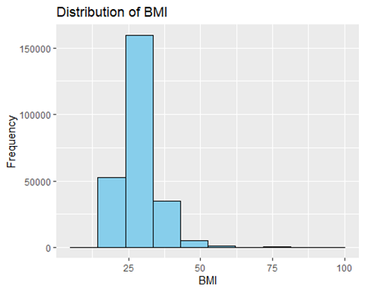
EXPLORATORY DATA ANALYSIS
1. Distribution of BMI
The BMI distribution is right-skewed, with most individuals having
a BMI in the range of approximately 25 to 35.
Very few individuals have BMI values exceeding 50, indicating
that extremely high BMI values are rare in this dataset.

Slide 12
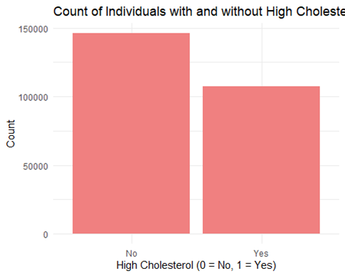
EXPLORATORY DATA ANALYSIS
2. Count of Individuals with and without High Cholesterol (Middle Chart):
There are more individuals without high cholesterol
compared to those with high cholesterol.
The imbalance in the count suggests that high
cholesterol is less common in this dataset.

Slide 13
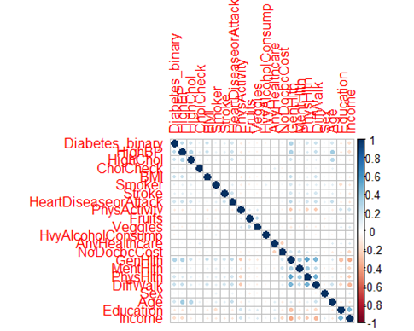
EXPLORATORY DATA ANALYSIS
3. Correlation Matrix (Right Chart):
The correlation matrix visually represents the relationships
between multiple variables.
Darker blue dots indicate a strong positive correlation,
while darker red dots indicate a strong negative correlation.
Observations:
Some variables have moderate to strong correlations,
potentially indicating interdependence (e.g., income and education).
Variables like "Diabetes_binary" and "HighChol" may have
correlations worth exploring further in relation to chronic disease outcomes.

Slide 14
VARIABLE DISCRIPTION TABLE
Model | Accuracy | Kappa | Sensitivity | Specificity | Pos Pred Value | Neg Pred Value | Balanced Accuracy | Comments
Random Forest | 0.8621 | 0.063 | 0.99458 | 0.04404 | 0.86536 | 0.56813 | 0.51931 | High sensitivity but poor specificity; significant bias towards the majority class.
Random Forest (ROSE Balanced) | 0.6913 | 0.2283 | 0.6916 | 0.6892 | 0.9322 | 0.2657 | 0.6904 | Rebalancing improved balanced accuracy but overall accuracy decreased.
XGBoost | 0.7218 | 0.307 | 0.8057 | 0.7082 | 0.3089 | 0.9575 | 0.7570 | Improved balance between sensitivity and specificity compared to Random Forest.
XGBoost (ROSE Balanced) | 0.8064 | 0.3454 | 0.5835 | 0.8425 | 0.3748 | 0.9259 | 0.713 | Higher specificity but lower sensitivity after balancing the dataset.

Slide 15
Conclusion and Future Directions
Conclusion and Vision for Future Work:
Summary: Our project leverages the CDC's BRFSS dataset to identify how health factors contribute to diabetes risk. By understanding these relationships, we aim to provide actionable insights for public health interventions focused on preventing diabetes through lifestyle modifications.
Next Steps: we will apply machine learning modeling to predict diabetes outcomes using the diabetes dataset. We will explore various algorithms, such as logistic regression, decision trees, to identify the most effective model. To optimize model performance, we will implement Grid Search Cross-Validation (CV), which systematically tests a range of hyperparameters for each model. The best-performing model will be selected based on metrics such as accuracy, precision, and recall, ensuring robust predictions for diabetes classification.

Slide 16
Key References
Primary Data Source: CDC's Behavioral Risk Factor Surveillance System (BRFSS).
Key Research Papers:
Hu F. B., Manson J. E., Stampfer M. J. et al. (2001). Diet, Lifestyle, and the Risk of Type 2 Diabetes in Women.
Lindström J., Tuomilehto J. (2003). The Diabetes Risk Score: A Practical Tool to Predict Type 2 Diabetes Risk.
Colberg S. R., Sigal R. J., Fernhall B. et al. (2010). Exercise and Type 2 Diabetes: The American College of Sports Medicine and the ADA Joint Position Statement.
Additional Resources: American Diabetes Association (ADA), World Health Organization (WHO) Factsheets.

